Slide 1

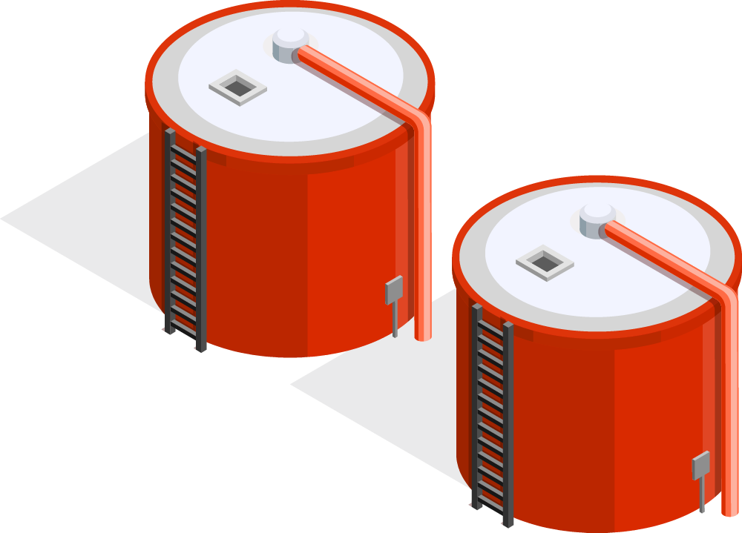
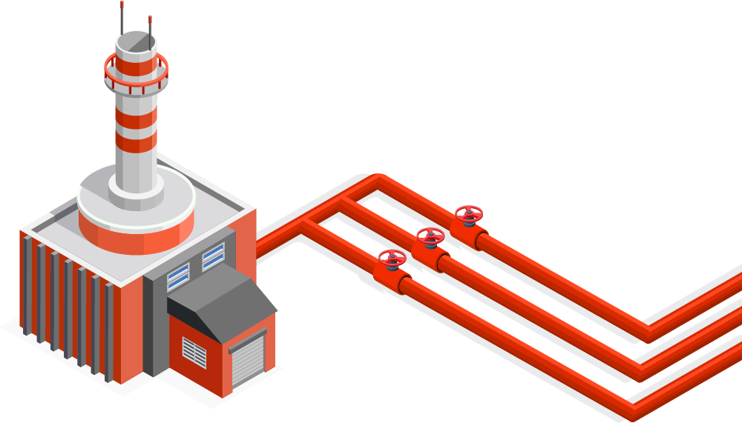
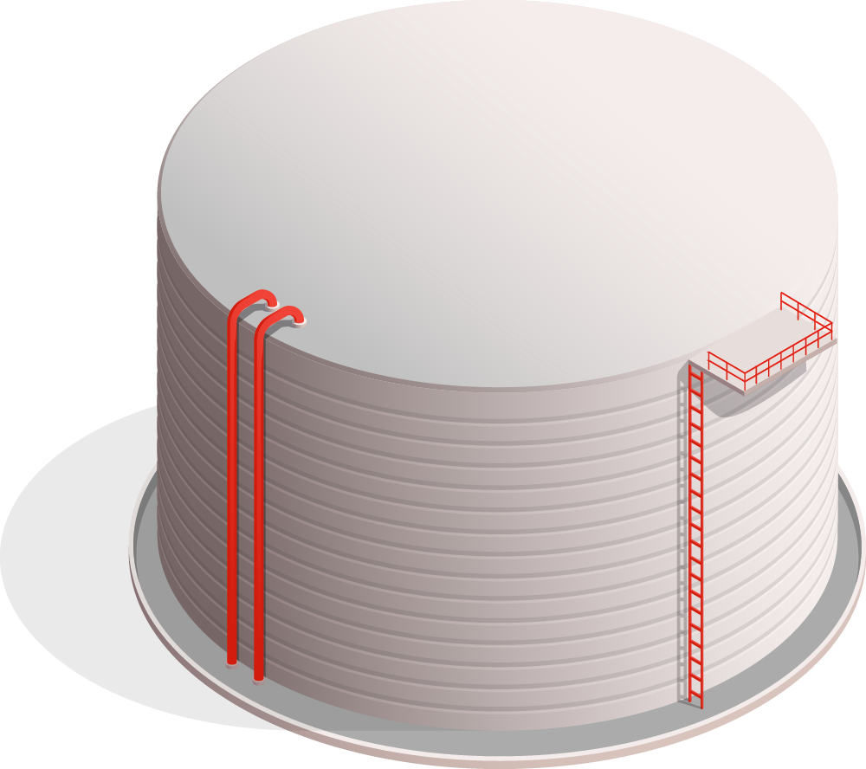
Optimisation of Operational and Sustainability Practices
For Aramco
Seminar Group 4 Team 3
Ayesha U2220739H
Jian Bo U2110567D
Sailesh U2221329C
Xinyi U2221219H
Liyi U2220985F

Slide 2
Table of contents
Introduction
Value Addition
01
02
Methodology
Results
Implementation
03
04
05
P
Opportunity statement
Benefits to Aramco and their stakeholders
Data Modelling
Analysis of data models
How Aramco can utilise our results

Slide 3

Introduction
01
Opportunity Statement

Slide 4


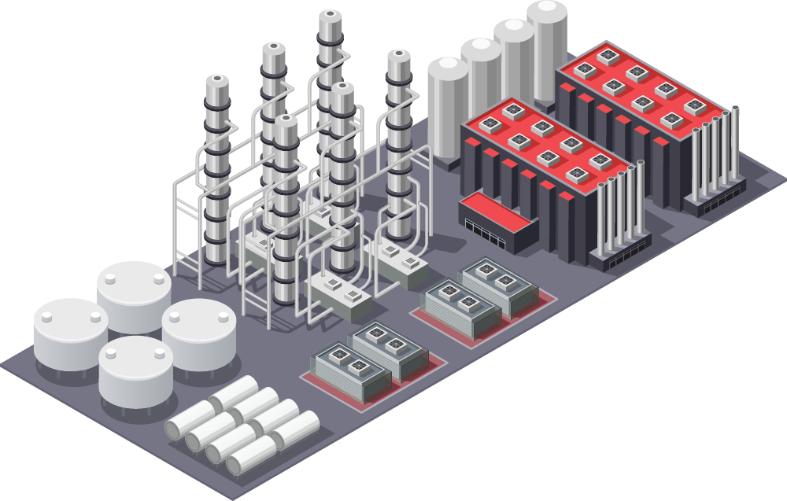
About Aramco
Sailesh
Largest daily oil production
US$ 535b earned in 2022
2nd largest public company

Slide 5



Opportunity for Aramco
Sailesh
Operational
Efficiency
Predictive Analysis
Alternative
Energy

Slide 6

Enhancing Operational
Efficiences
Sailesh

Slide 7

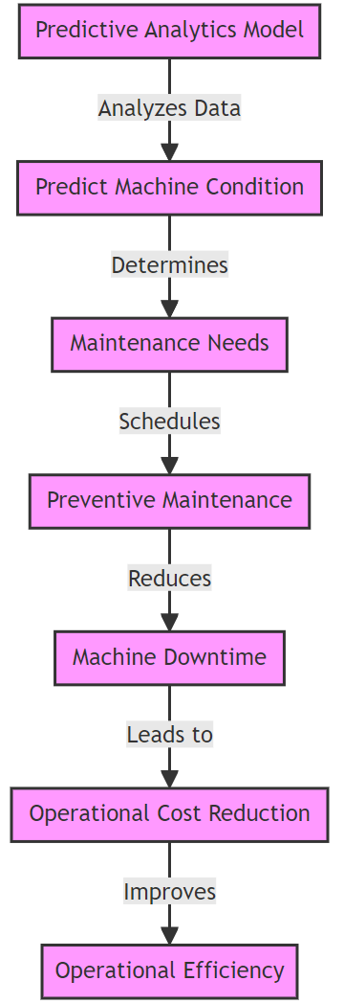
Predictive Maintenance up to 10 times cheaper
Sailesh

Slide 8
Forecasting Demand for Renewable Energy
Sailesh

Slide 9
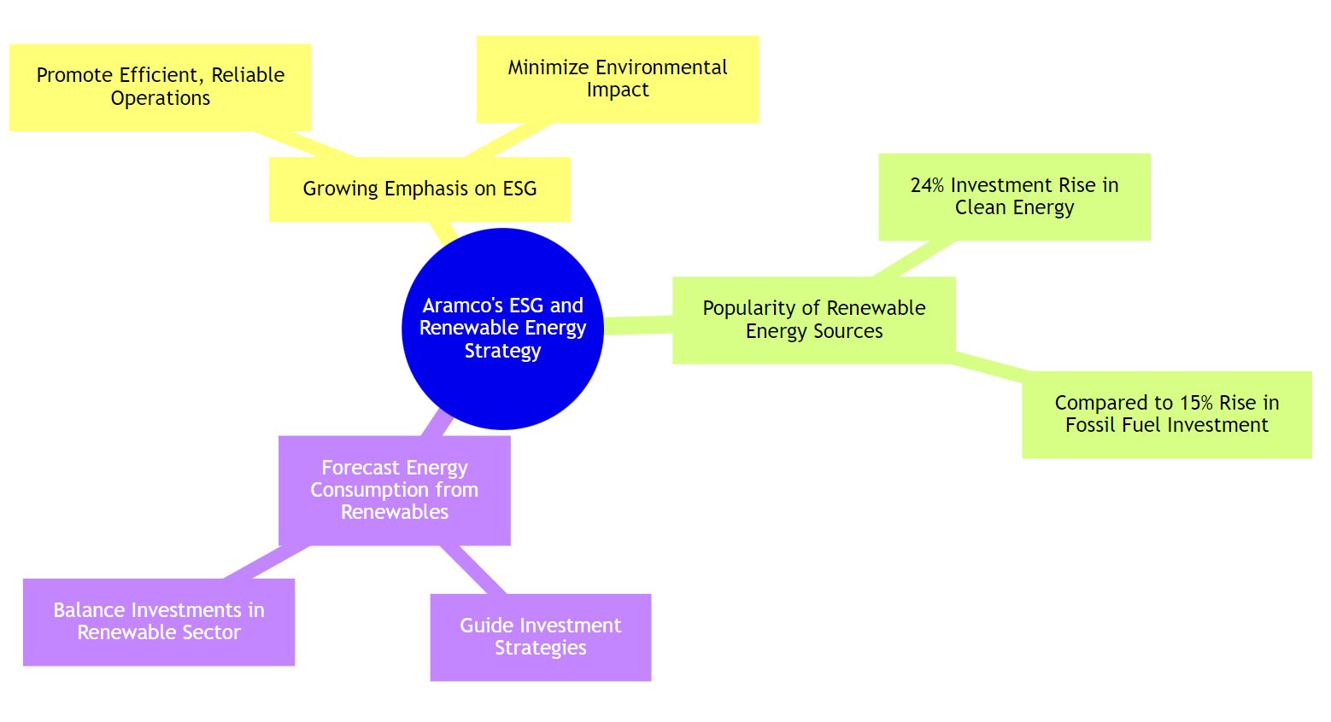
Sailesh

Slide 10
Value Addition
02
How our solutions add values to the company and their stakeholders

Slide 11

Value Addition to Aramco
Operational Efficiency Enhancement
Xinyi
Accurate prediction of machine conditions and maintenance needs.
Proactive maintenance to reduce downtime and costly machine failures.

Slide 12

Value Addition to Aramco
Resource Allocation Optimization
Xinyi
Predictive analysis of future renewable energy share.
Guideline for oil production aligned with market demand.

Slide 13

Value Addition to Aramco
Diversification into Renewable Energy
Xinyi
Exploring opportunities in the renewable energy sector.
Focusing on solar panels for small to medium-sized firms.
Expanding revenue streams while aligning with ESG goals.

Slide 14
Value Addition to Aramco’s Stakeholders
Xinyi
Investors
Government
Businesses
01
02
03
Empowered with knowledge of renewable energy trends.
Able to capitalize on promising opportunities.
Enhanced confidence in Aramco's stability and reliability.
Positive alignment with ESG policies.
Utilizing predictions for infrastructure and incentives.
Boosting economic efficiency and responsible resource management.
Refining business strategy with industry trends.
Leveraging our proposal for partnerships.
Enhancing supply chain reliability.

Slide 15
Methodology
03
How we made use of our data for analysis

Slide 16
Data selection
Volume
Accuracy
01
02
Timeliness
03
Jian Bo
Large volumes of data will be easier to analyse for the discovery of any patterns, correlations, and clustering for deeper insights
Having data that align closely with the actual characteristics of events being recorded which can allow for more reliable analysis
Having up to date data is also very important as it allows us to perform more timely predictions for the coming year.

Slide 17
Datasets used
Renewable energy demand
Machine failure
Jian Bo
Identify significant factors that predict when machine failure will occur.
Identify key factors to reliably predict future renewable energy demand.

Slide 18
Linear Regression
01
Assumptions
02
Application
03
Potential Problems
04
Backward Elimination
05
Interpreting data
Jian Bo
The independent variables and dependent variable are linearly related
Through application of a linear approach to model the relationship between the variables, we will then be able to determine the significance of the independent variables when predicting the dependent variable.
Large number of independent variables could result in multicollinearity, which our team overcame through calculating the variance inflation factor (VIF) through the ratio of overall model variance of each specific variable
To simplify the process, we made use of the step function which would remove independent variables that resulted in the highest impact on the equation until the optimal model is reached.
To interpret the optimal model that is generated, we will have to look at the coefficients of the model where it shows the relationship between the individual variables with the dependent variable.

Slide 19
Classification and Regression Tree
01
Assumptions
02
Application
03
Potential Problems
04
Pruning
05
Interpreting data
Jian Bo
No assumptions are needed when using the CART model
Decision Tree is grown to the maximal using the Gini Index through testing independent variables to determine the best split, splitting continues until the largest tree is achieved.
A decision tree that is grown to the maximum is very likely to be overfitted and there will be too many decision nodes for any meaningful analysis. Hence , we will find optimal model between the max and min tree.
To achieve the optimal tree, we will do pruning through using the prune function which will automatically determine the first node where the mean error is lower than the sum of squared errors (SSE)
To interpret the optimal model that is generated, we will have to look at the decision nodes to determine which variables are significant for obtaining the terminal nodes that are optimal to us

Slide 20
Comparison between both models
Linear Regression
CART
Similarities
Jian Bo
P
Assumes a linear relationship between independent and dependent variables.
Independent variables are normally distributed
Data has to be cleaned as linear regression will skip through NA values
Comprehensive model that is capable of dealing with data regardless of linearity
Able to deal with missing value through replacing them with surrogates
More difficult to interpret than Linear Regression
We will make use of the 70 - 30 train - test split to prevent overfitting of the models as we can make use of the test set to test the predictive capabilities of the model.

Slide 21
Results & Analysis
04
The interpretation of our results and model comparison

Slide 22
Key Predictor Variables
Predicting Machine Failure
Logistic Regression
CART
Ayesha
P
Rotational speed
Torque
Tool wear
Air temperature
Process temperature
Rotational speed
Torque
Tool wear
Air temperature
Process temperature

Slide 23
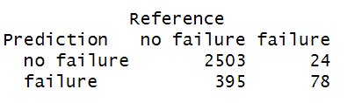
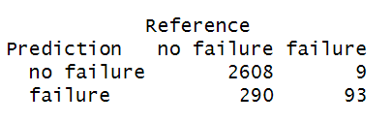
Model Comparison
Predicting Machine Failure
Logistic Regression
CART
Ayesha
Positive class: ‘no failure’, Negative class: ‘failure’

Slide 24
Model Comparison
Predicting Machine Failure
Ayesha
 | Logistic Regression | CART
Misclassification Error | 14 % | 10 %
True Negative Rate | 76 % | 91 %
False Positive Rate | 24 % | 9 %
Positive class: ‘no failure’, Negative class: ‘failure’

Slide 25
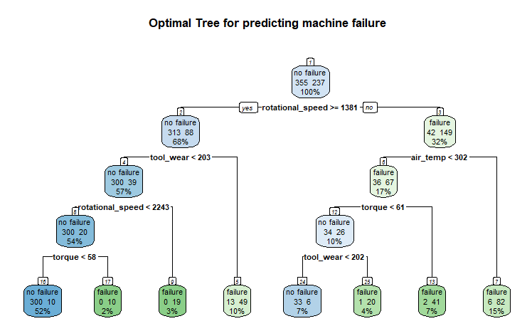
CART Model
Predicting Machine Failure
Ayesha

Slide 26
Key Predictor Variables
Predicting Renewable Energy Share
Linear Regression
CART
Ayesha
P
C02 Emission
Energy intensity
C02 Emission
Energy intensity

Slide 27
Model Comparison
Predicting Renewable Energy Share
Ayesha
 | Linear Regression | CART
RMSE (train set) | 24 | 20
RMSE (test set) | 24 | 25
RMSE: the average difference between the actual and predicted values

Slide 28
Linear Regression Model
Predicting Renewable Energy Share
Ayesha
=
Renewable energy share
40 + 22 Energy Intensity - 4 C02 Emissions
C02 Emissions have a negative correlation with renewable energy share

Slide 29


Limitations
Ayesha
Incomprehensive Predictor Variables
Vulnerability to Unforeseen Circumstances

Slide 30
05
Implementation
How Aramco can adapt and implement our idea

Slide 31
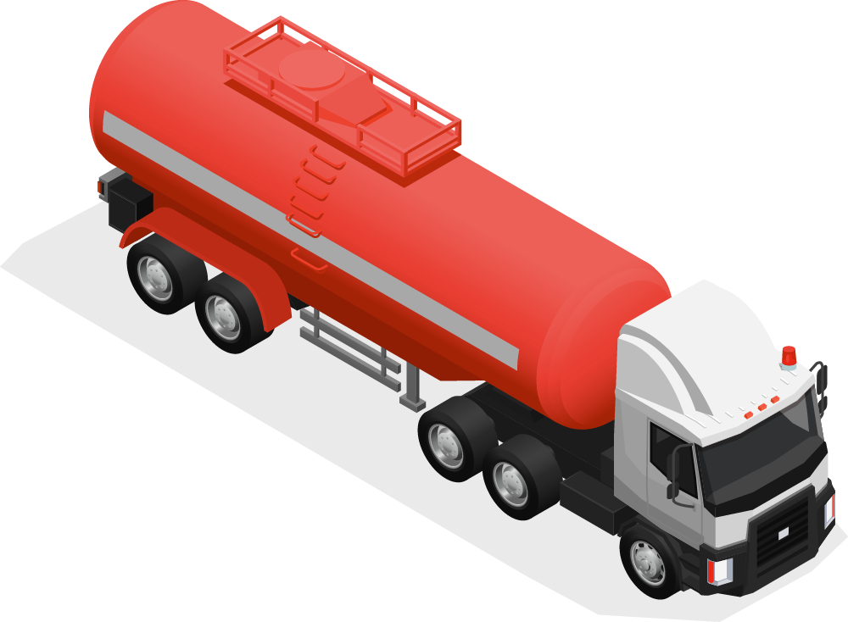
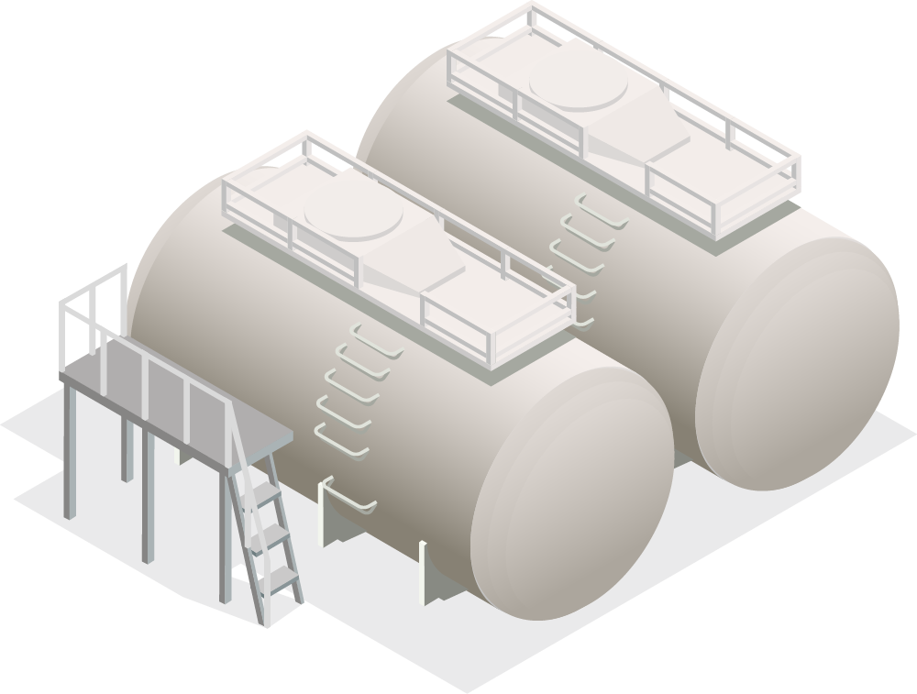
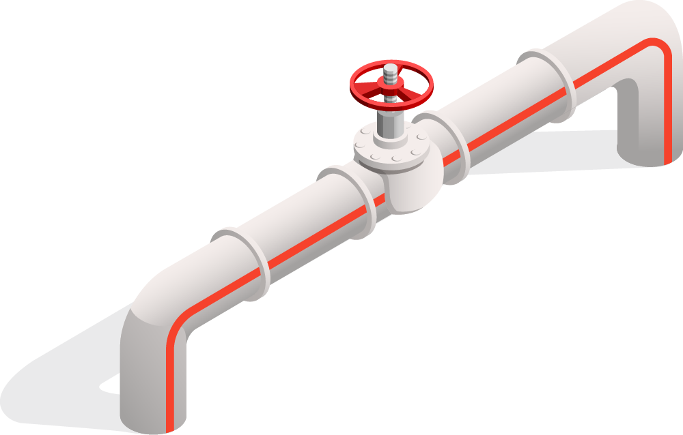
$5,000,000+
Liyi
Less than 4 days of unplanned downtime will cost
27 DAYS!
Notes:
According to market research, less than four days of unplanned downtime costs an oil and gas company over $5 million, with most companies averaging 27 days of annual unscheduled downtime
Therefore, Aramco can use the given data and the rules derived from our Logistic Regression and CART model for predictive maintenance to Enhance operational efficiencies in the following ways:

Slide 32
Predictive Maintenance
Rule-Based Alerts through Real-time Monitoring
Liyi
Using the CART model, a monitoring system can be implemented that triggers alerts when the conditions specified in the rules are met.
The logistic regression model can provide probabilities of failure, which can be used alongside the rule-based system to make better decisions.
Notes:
Using the CART model, a monitoring system can be implemented that triggers alerts when the conditions specified in the rules are met. For example, if the rotational speed drops below 1381 and the air temperature is above 302, an alert for potential failure is issued. This can be integrated with the logistic regression model that identifies Torque, Rotational Speed, and Tool Wear as the most statistically significant variables. The logistic regression model can provide probabilities of failure, which can be used alongside the rule-based system to make more nuanced decisions. This probability provides a more granular risk assessment than the binary output of the rule-based system. Each piece of equipment can be assigned a risk score based on the logistic regression model's output. This score reflects the current probability of failure and can be updated in real-time as the input variables change. The risk score can be used to prioritise maintenance actions. Equipment with higher scores would be attended to first, as they are at a higher risk of failure.

Slide 33
Predictive Maintenance
2. Operational Adjustments
3. Resource Optimization
Liyi
Adjust operational parameters that are significant to avoid entering high-risk zones.
Prioritise maintenance resources to equipment that frequently operates near the failure conditions.
Notes:
Aramco can adjust operational parameters that are significant based on the regression model and CART model to avoid entering high-risk zones. For instance, if tool wear is approaching 190 and other conditions are close to the failure thresholds, operations can be modified to reduce stress on the equipment.
Prioritise maintenance resources to equipment that frequently operates near the failure conditions. This helps focus efforts where they are most needed, potentially reducing downtime and maintenance costs.

Slide 34

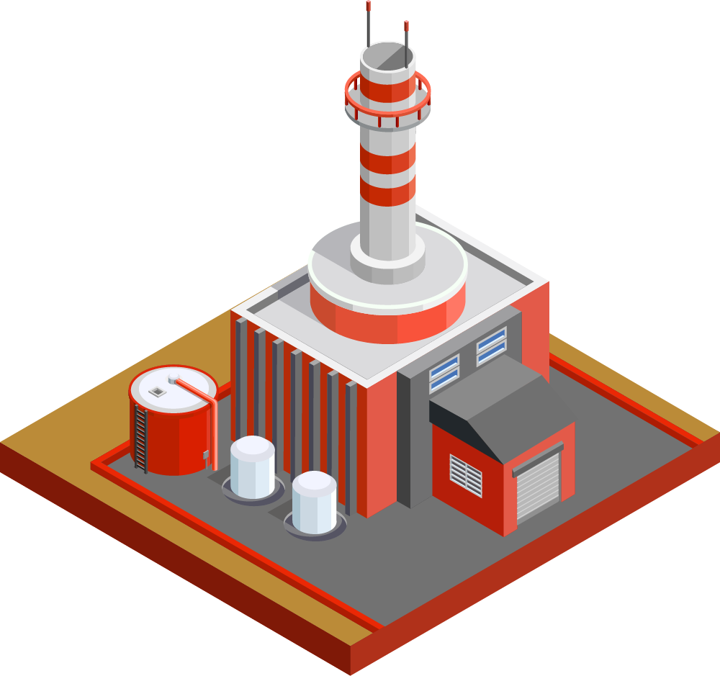
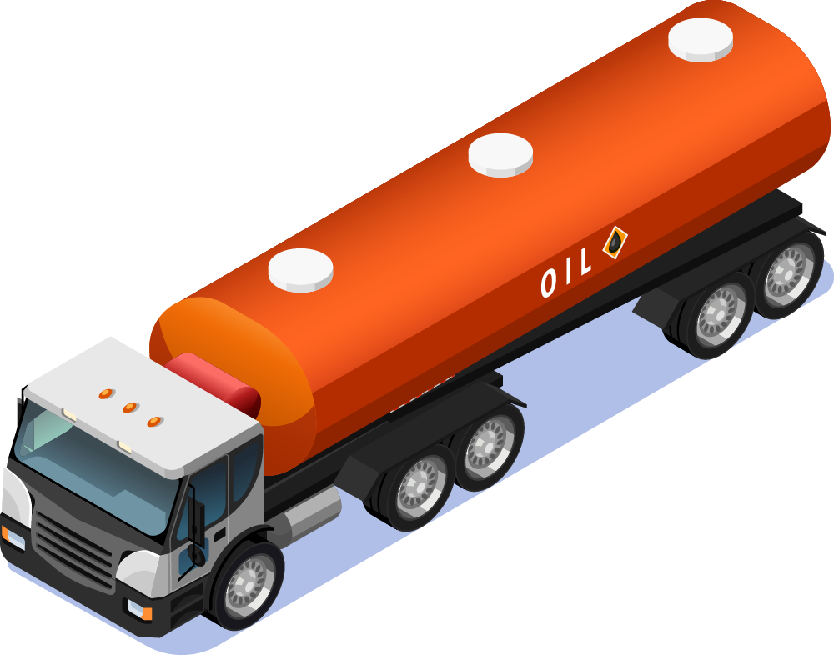
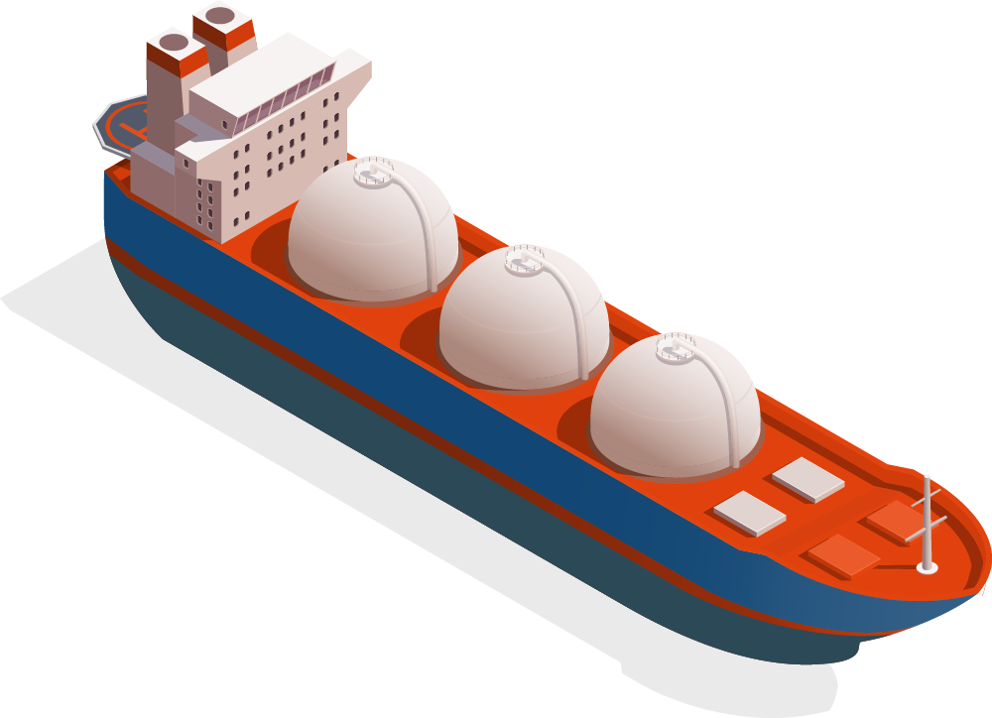
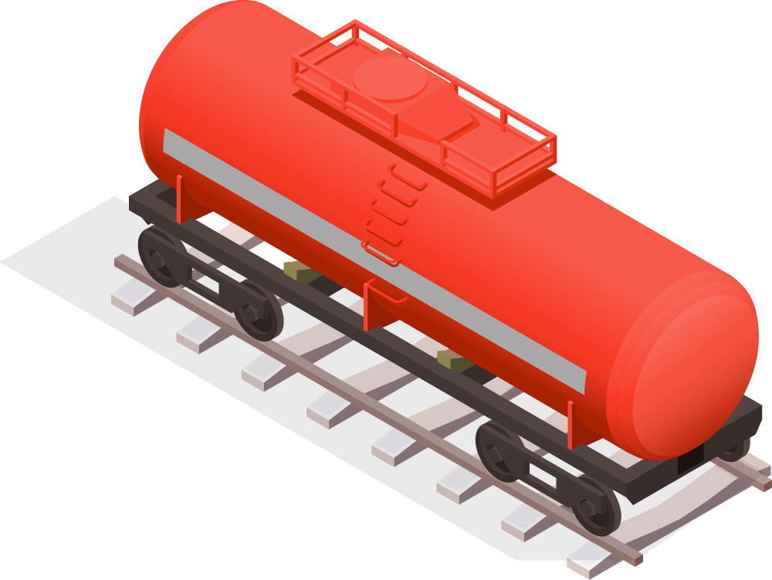
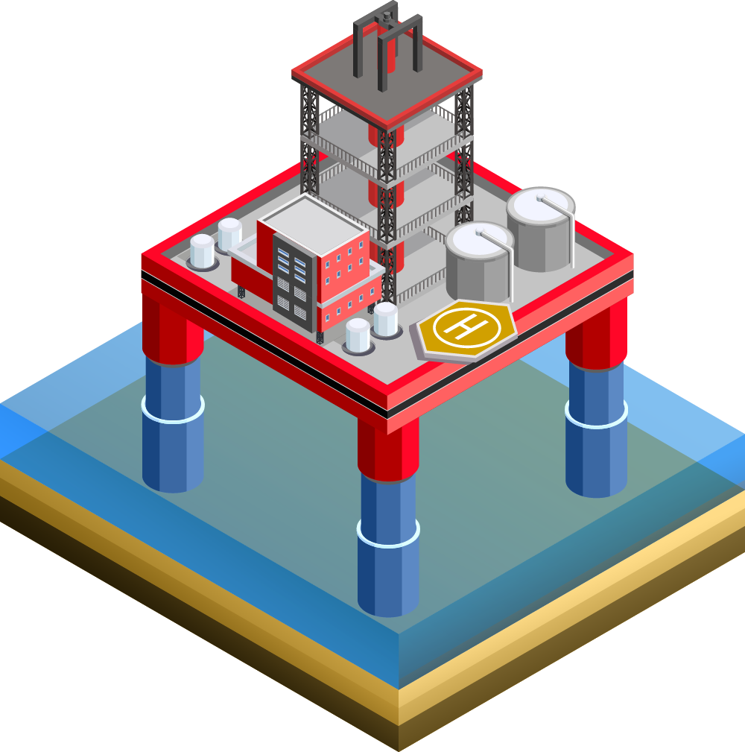


Predictive Maintenance
4. Equipment Design and Purchasing
Liyi
Aramco can use the data to make informed decisions in the design and purchase of new equipment.
New equipment can be designed or selected to operate more reliably under those conditions.
Companies using predictive maintenance achieve a 5 to 10% improvement in production efficiency, and a 20 to 30% decrease in maintenance costs compared to using time-driven maintenance philosophies.
Notes:
Aramco can use the data to make informed decisions in the design and purchase of new equipment. If certain operational parameters are associated with higher failure rates, new equipment can be designed or selected to operate more reliably under those conditions.
Moreover, companies using predictive maintenance achieve a 5 to 10 per cent improvement in production efficiency, and a 20 to 30 per cent decrease in maintenance costs compared to using time-driven maintenance philosophies (Christiansen, 2023). Additionally, they claim a 30 to 50 per cent reduction in downtime on critical machines. As such, using our analysis can help Aramco create a dynamic predictive maintenance program that not only prevents failures but also optimises the performance and lifespan of its equipment. This approach can lead to significant cost savings, improved safety, and increased operational efficiency.

Slide 35
Navigating the Alternative Energy Market
Demand Forecasting
2. Market Diversification Strategies
Liyi
Linear Regression using C02 Emissions and Energy Intensity.
Aramco can implement a demand forecasting system using these variables as key inputs.
Aramco can target investment in renewable energy in regions where C02 Emissions and energy intensity cross the identified thresholds, which indicate a high potential for renewable adoption.
This will allow Aramco to make more precise investment decisions.
Regions with higher energy intensity are more likely to adopt renewable energy sources more aggressively.
Notes:
Linear Regression indicates a negative coefficient for C02 Emissions (-3.9868) and a positive coefficient for Energy Intensity (22.3183). Aramco can implement a demand forecasting system using these variables as key inputs to model, as well as predict the future demand for oil versus renewable energy sources. Aramco’s navigation through the alternative energy market can be enhanced by leveraging the insights provided by the Linear Regression and CART models.
The CART model predicts a 68% renewable energy share when C02 Emissions are greater than 9.7 and Energy Intensity is greater than 1.3. Aramco can target investment in renewable energy in regions where C02 Emissions and energy intensity cross the identified thresholds, which indicate a high potential for renewable adoption. This will allow Aramco to make more precise investment decisions. Moreover, the high positive coefficient of Energy Intensity in the Linear Regression model indicates that regions with higher energy intensity are more likely to adopt renewable energy sources more aggressively. Through analysing regions which have a higher or growing energy intensity, Aramco can better predict future hotspots for renewable energy demand and adjust its strategies accordingly.

Slide 36
Navigating the Alternative Energy Market
3. Policy Analysis
Liyi
C02 Emissions and Energy Intensity in the Linear Regression model highlight that policy changes affecting these variables are likely to have a significant impact on the renewable energy market.
Aramco can engage in policy analysis and advocacy in line with their ESG goals.
Aramco could also create an adaptive business model that can capture the impact on renewable energy demand accurately.
Notes:
The significant variables, C02 Emissions (5.87e-0.5) and Energy Intensity (2.71e-0.6) in the Linear Regression model highlight that policy changes affecting these variables are likely to have a significant impact on the renewable energy market. Aramco can engage in policy analysis and advocacy in line with their ESG goals, to anticipate and influence certain regulations that may affect the energy market, as well as prepare mitigation strategies for scenarios where policy changes could potentially impact the oil and energy market unfavourably.
Aramco could also gather more data and expand the range of data sources to include more variables such as technological innovation rates, and political climate, which are also likely to affect the renewable energy market, to create an adaptive business model that can capture the impact on renewable energy demand accurately. By continuously feeding new data into existing models, Aramco can refine the models’ predictive accuracy. Through this adaptive approach, Aramco will be able to gain a more comprehensive understanding of the demand of both oil and renewable energy, allowing the company to make more informed decisions regarding the balance between oil and renewable energy investments.

Slide 37
Thank you!
Liyi
Do you have any questions?
Please keep this slide for attribution

